Slide 1

Welcome to Asianhack 20222

Slide 2

Asianhack 2022
Presents
Introduction to Git

Slide 3
~# whoami
~ Bipin Thapa
~ Freelance Full Stack Web Developer
~ Web App Pentester and Security Researcher
~# social-links
~ twitter - kaji0x01
~ github – bipin0x01
~ facebook – bt.kaji

Slide 4
What is Git?
Git is an open source version control system that is used for tracking project progress.
It helps to work collaboratively in a team nonetheless the number of team members.
We can easily track changes made on codes and projects.

Slide 5
Why Git?
Sharing codes among developers over medium like google drive is tedious, with verson control system we can easily share the codes.
Git uses the concept of distributed systems I.e your project is stored in the central system and a copy in each developers development server or simply a personal computer.

Slide 6
Get Started with Git
Installation
For Windows
This link has details on how to install Git in multiple operating systems: https://git-scm.com/book/en/v2/Getting-Started-Installing-Git
For Linux
https://git-scm.com/download/linux
Or,
Use the following commands
apt-get install git

Slide 7
Git 101
In git, a unit system is used for representing a project which is called repository.
A repository is basically a project folder that is hosted in a central system which may contain sub-folders, images, texts and other files.
Furthermore, the repository is marked into two categories:
Remote repository
Local repository

Slide 8
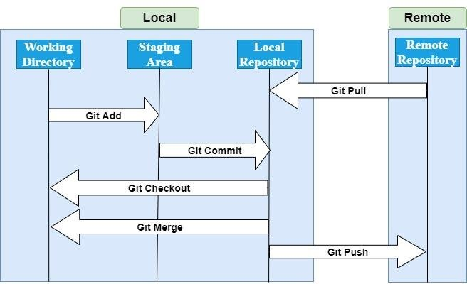
Working with git

Slide 9
Intro to Github
Github is a code hosting provider that leverages the power of git version control.
It serves as the central system for storing the projects.
Founded in 2007 , It is the most widely used code hosting platform.

Slide 10
Git = Github ?
Although Git and github looks like the same thing, IT ISNT !
Git is the original open source system that is used for version control while github is a separate company that uses the git .
Some other examples of code hosting platforms are gitbucket, bitbucket, gitlab, etc
All of them use git as version control system.

Slide 11
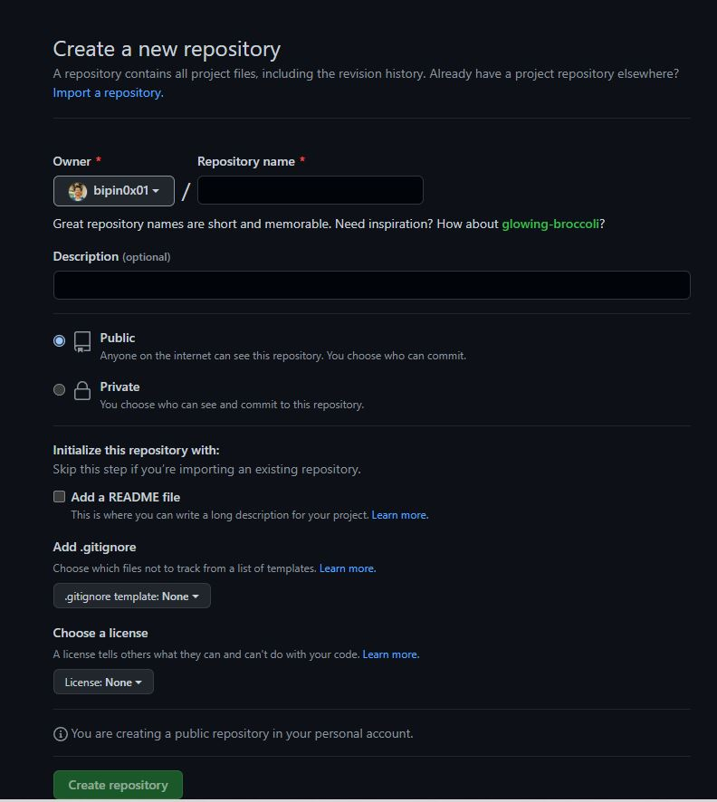

Slide 12
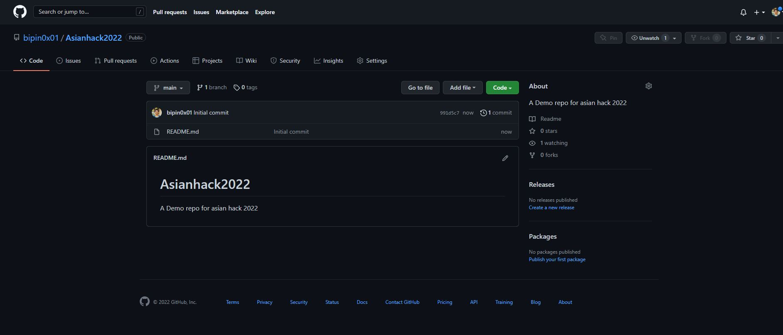

Slide 13
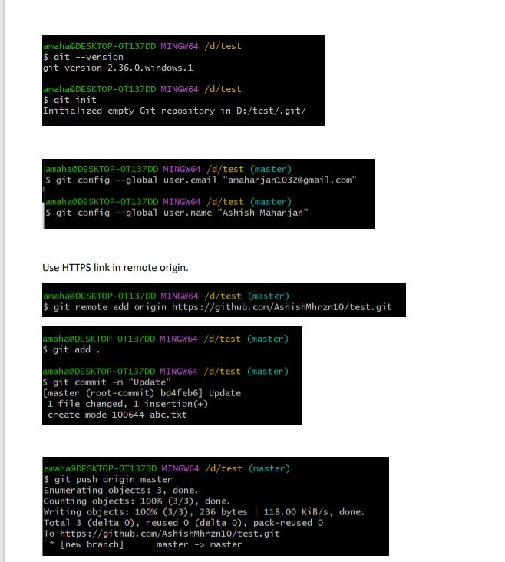
Boom! The first Commit
~ git init
~ git config –global user.email "{your github email}"
~ git config –user.name "{your name}"
~ git remote add origin {link to your repo}
~ git add .
~ git commit –m "{commit message}"
~ git push origin '{branch name}'

Slide 14


